Slide 1
Unit 1 INFORMATION SYSTEM
3 Hrs
Presented by
Er.Harendra Bikram Shah
Lecturer
Department of BE Computer

Slide 2
OUTLINES
1.1.Classification and Evolution of IS
1.2.IS in Functional Areas
1.3. Information System Architecture
1.4. Qualities of Information System
1.5. Managing Information System Resources
1.6. Balanced Scorecard-Case Studies

Slide 3

Introduction To IS
Information system is on organized combination of people, hardware, software, communication networks and data resources that collects, stores, and process data as well as delivers information, knowledge in an organization.
An information system is any organized system for the collection, organization, storage and communication of information.
Data:
Information:.
Three main categories in Information
• Strategic Information:
• Tactical Information:
• Operational Information:
System: The word system is taken from Greek word "Systema" which means an "organized collection".

Slide 4
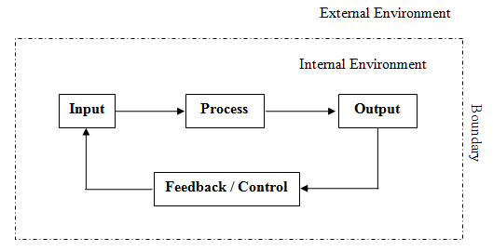
Fig: A complete System

Slide 5
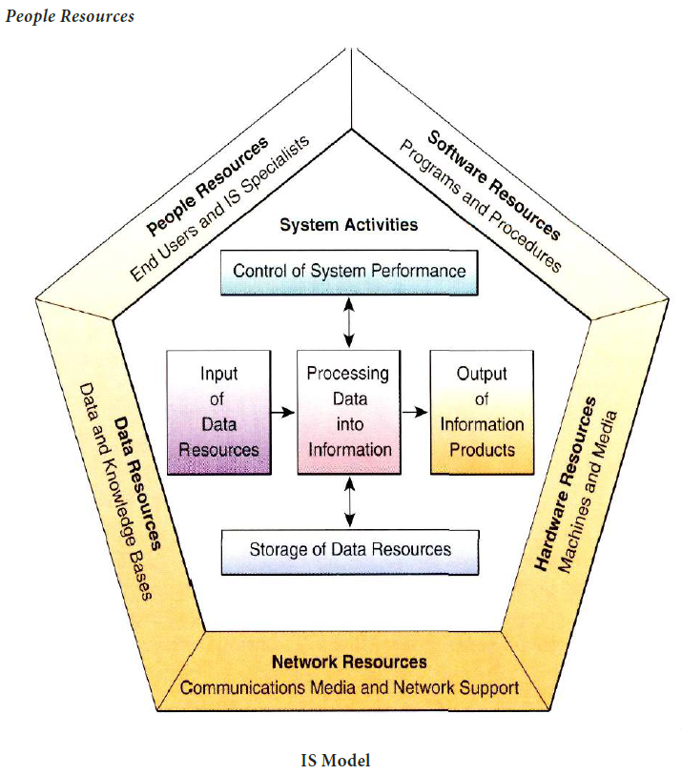
COMPONENTS/RESOURCES OF IS

Slide 6
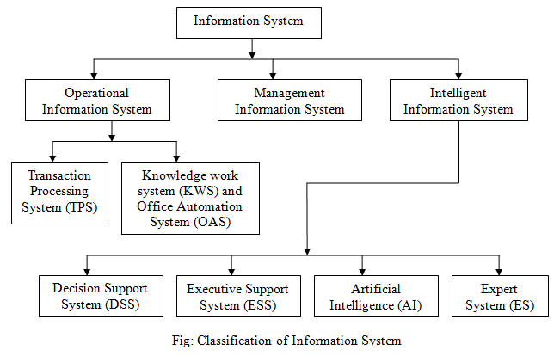
TYPES OF IS

Slide 7
Evolution/History of IS
Era | Timeline | Key Technologies | Focus | Examples
Early Systems (1800s-1950s) | Abacus, punch card systems, mechanical calculators | Manual data processing | - Automation of basic tasks | Accounting systems inventory management
Mainframe Era (1950s-1970s) | Mainframe computers, punch cards, magnetic tape storage | Centralized data processing | Increased efficiency and data storage | Transaction processing systems (e.g., payroll)
Mini-computer Era (1970s-1980s) | Minicomputers, magnetic disks | Decentralized computing | Departmental computing and decision-making | Sales & marketing systems
Personal Computer Era (1980s-1990s) | Personal computers (PCs), relational databases, networking | Distributed computing, user-friendly interfaces | Individual productivity and departmental collaboration | Word processing, spreadsheets, early databases
Client-Server Era (1990s-2000s) | Client-server architecture, LANs, WANs, internet | Resource sharing, connectivity, distributed processing | Enterprise-wide information systems | Email, enterprise resource planning (ERP) systems
Web Era (2000s-Present) | World Wide Web, internet browsers, e-commerce | Global communication, information access, collaboration | E-business, mobile computing, cloud computing | E-commerce platforms, social media, mobile apps

Slide 8
INFORMATION SYSTEM IN FUNCTIONAL AREAS
Information Systems have a number of different areas of work:
IS strategy
IS management
IS development
IS iteration
It supports a functional area by increasing its internal effectiveness and efficiency.
Finance (FIN):
Accounting (ACC):
Marketing (MKT):
Operations (OPS):
Human Resources Management (HR):

Slide 9
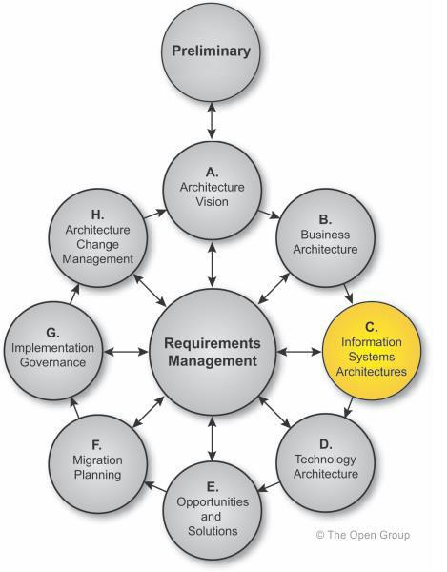
INFORMATION SYSTEM ARCHITECTURE
Fig: Architectural design of Information system

Slide 10
QUALITIES OF INFORMATION SYSTEM
Reliability
Timely
Relevant
Accurate
Sufficient
Unambiguous
Complete
MANAGING INFORMATION SYSTEM RESOURCES:

Slide 11
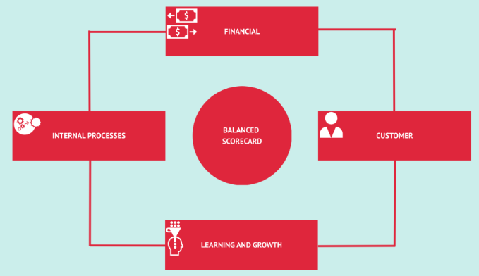
BALANCED SCORECARD-CASE STUDIES
The balance scorecard is used as a strategic planning and a management technique.
Used for organization's performance to its vision and objectives.
Developed by Robert S Kaplan and David P Norton,
Tool to improves the communication and feedback process between the employees and management and to monitor performance of the organizational objectives.
use by not-for-profit and public sector organizations.
The Basics of Balanced Scorecard:

Slide 12
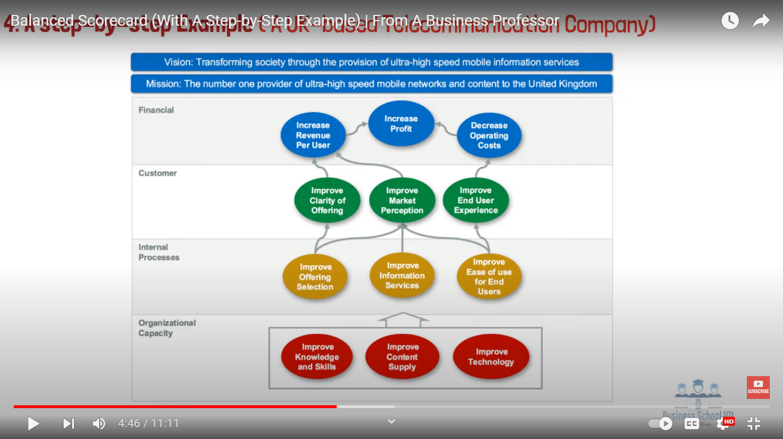

Slide 13
The Need for a Balanced Scorecard:
Increases the focus on the business strategy and its outcomes.
Leads to improvised organizational performance through measurements.
Align the workforce to meet the organization's strategy on a day-to-day basis.
Targeting the key determinants or drivers of future performance.
Improves the level of communication in relation to the organization's strategy.
Helps to prioritize projects according to the timeframe and other priority factors.

Slide 14
Questions to consider when implementing a Balanced Scorecard:
Do we have sufficient buy-in from top management?
Are we willing to engage in a more participatory strategy and performance management process?
Are we committed to the organizational change effort necessary for successful implementation?
To what extent will our current management information systems be able to support implementation? What are the costs and benefits of making these changes?
What are we already doing that we can incorporate into our scorecard? What do we need to modify or stop doing?
Are we prepared to focus our reporting around the scorecard?

Slide 15
INFORMATION SYSTEM VS Information Technology
Feature | Information System (IS) | Information Technology (IT)
Definition | An organized system for the collection, organization, storage, and communication of information | involved in the handling and processing of information, especially using computer systems
Focus | Framework, processes, procedures for effective information use | Hardware, software, networks for data processing and communication
Scope | Broader - includes technology, people, and processes | Narrower - focuses on the technological aspects
Role | Design, develop, implement, and manage information systems to support business goals | Provide and maintain the technological infrastructure for information systems
Skills | Business analysis, project management, understanding of business needs | Technical expertise in hardware, software, networks, and cybersecurity
Example | A customer relationship management (CRM) system used to track customer interactions | The network and database that support the CRM system

Slide 16
END of The UNIT 1

